Slide 1
Setup For Failure: Defeating Secure Boot
Corey Kallenberg @coreykal
Sam Cornwell @ssc0rnwell
Xeno Kovah @xenokovah
John Butterworth @jwbutterworth3

Slide 2
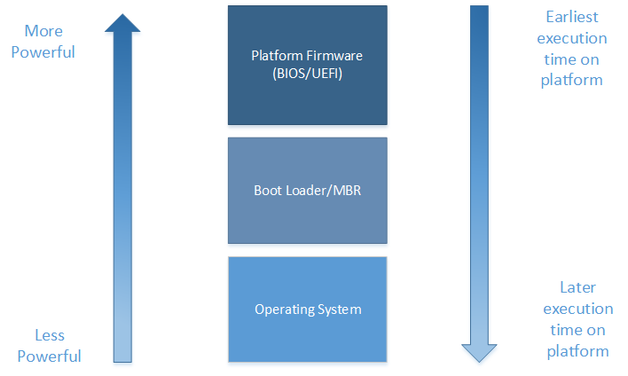



The Malware Food Chain
Rootkits that execute earlier on the platform are in a position to compromise code that executes later on the platform, making earliest execution desirable.
Notes:
http://www.search-best-cartoon.com/cartoon-fish.html

Slide 3
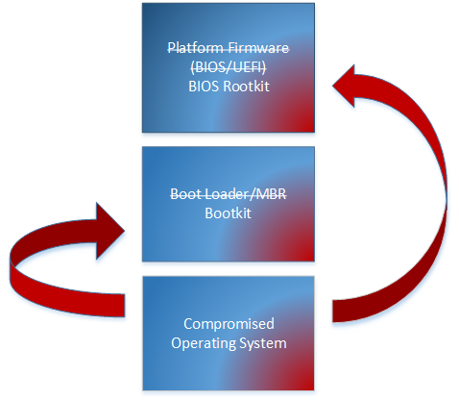



Malware Food Chain: Blood in the Water
It’s advantageous for malware to claw its way up the food-chain and down towards hardware.
Previously, malware running with sufficient privileges on the operating system could make malicious writes to both the Master Boot Record and the BIOS.
Notes:
http://www.clker.com/cliparts/p/S/D/m/Y/B/blue-shark-hi.png
http://www.search-best-cartoon.com/cartoon-fish/cartoon-fish-baracuda.jpg
http://www.search-best-cartoon.com/cartoon-fish.html
http://graemehobbs93.wordpress.com/category/drawings/page/2/ - http://graemehobbs93.files.wordpress.com/2012/01/piranha.gif

Slide 4
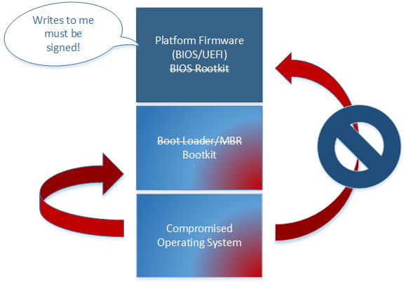
Many modern platforms implement the requirement that updates to the firmware must be signed. This makes compromising the BIOS with a rootkit harder.

Slide 5
More on Signed BIOS Requirement
Signed BIOS recommendations have been around for a while now and preceded widespread adoption of UEFI.
Not perfect, but significantly raises the barrier of entry into the platform firmware.
“Attacking Intel BIOS” by Rafal Wojtczuk and Alexander Tereshkin.
“Defeating Signed BIOS Enforcement” by Kallenberg, Butterworth, Kovah and Cornwell.

Slide 6
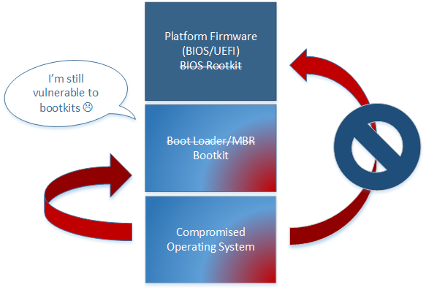

Signed BIOS requirement did not address malicious boot loaders, leaving the door open for bootkits/evil maid attacks.

Slide 7

Enter UEFI
UEFI has largely replaced conventional BIOS for PC platform firmware on new systems.
UEFI 2.3.1 specifies a new security feature “Secure Boot” in order to address the bootkit vulnerability present on conventional BIOS systems.
When enabled, Secure Boot validates the integrity of the operating system boot loader before transferring control to it.

Slide 8
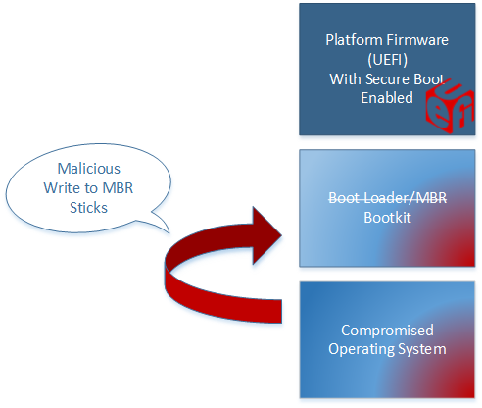
Secure Boot does not prevent the initial malicious write to the boot loader (unlike signed bios enforcement)

Slide 9
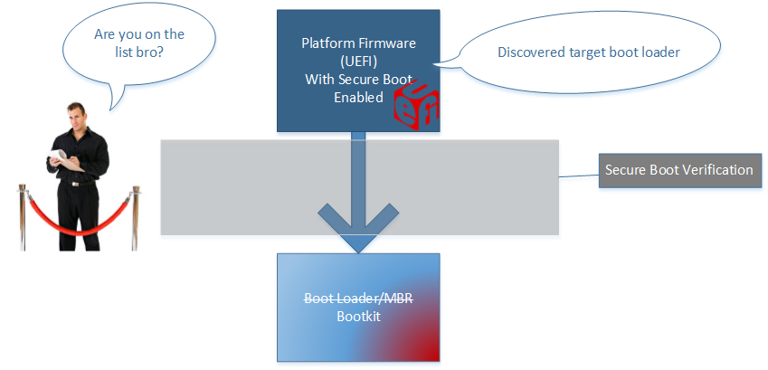
Upon discovery of the overwritten (malicious) boot loader, the platform firmware will attempt to cryptographically verify the integrity of the target OS loader.

Slide 10
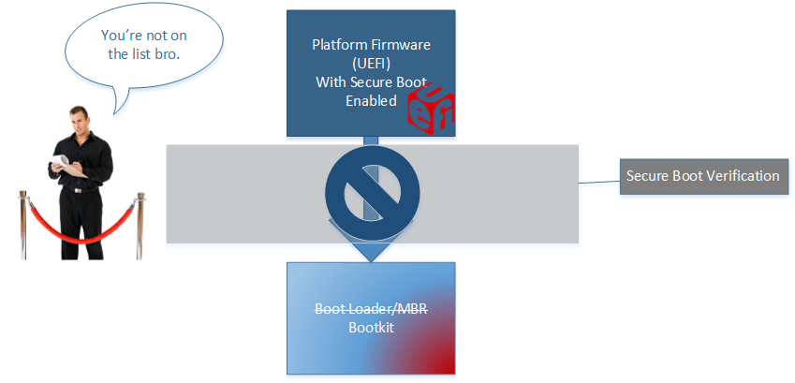
Because the boot loader is not signed with a key embedded into the firmware, UEFI will refuse to boot the system.

Slide 11
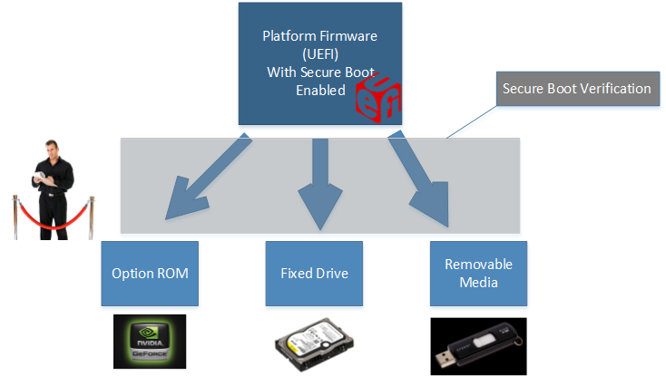
Secure Boot is not limited to verifying only the boot loader.
Secure Boot will attempt to verify any EFI executable that it attempts to transfer control to.
Sort of..

Slide 12
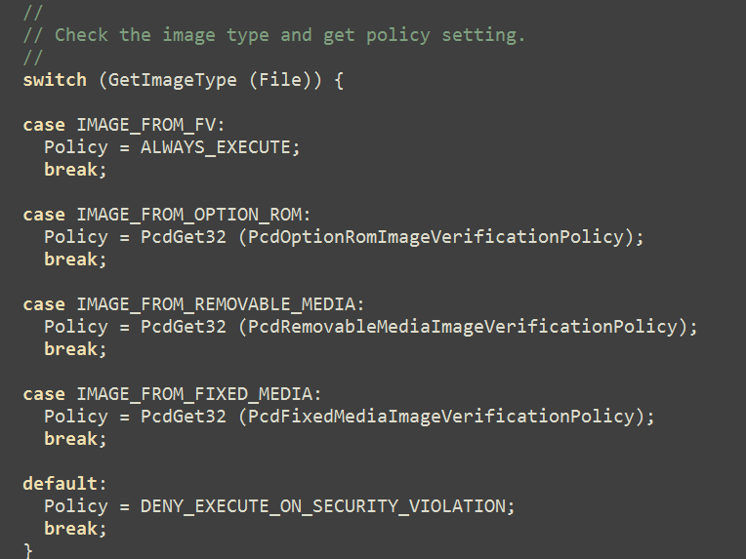
The signature check on target EFI executables doesn’t always occur.
Depending on the origin of the target executable, the target may be allowed to execute automatically.
In the EDK2, these policy values are hard coded.
Code from EDK2 open source reference implementation available at:
https://svn.code.sf.net/p/edk2/code/trunk/edk2

Slide 13
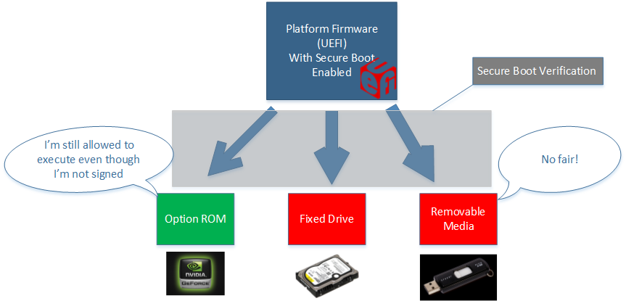
For instance, an unsigned option ROM may be allowed to run if the OEM is concerned about breaking after market graphics cards that the user adds in later.

Slide 14
Attack Proposal
If a Secure Boot policy was configured to allow unsigned EFI executables to run on any mediums that an attacker may arbitrarily write to (boot loader, option rom, others…) then other legitimate EFI executables can be compromised later.

Slide 15
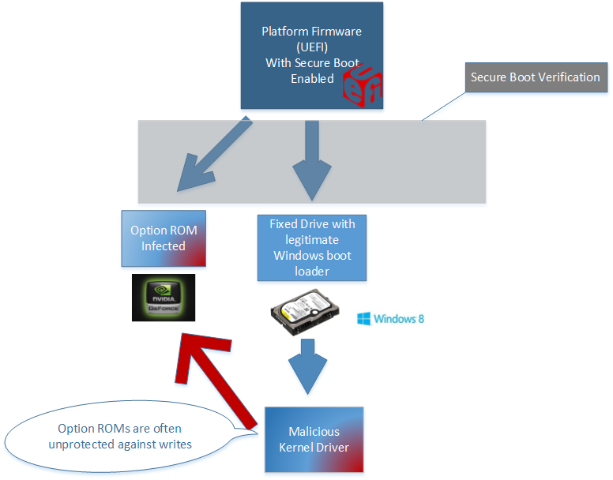
The malicious option rom will run before the legitimate Windows boot loader.

Slide 16
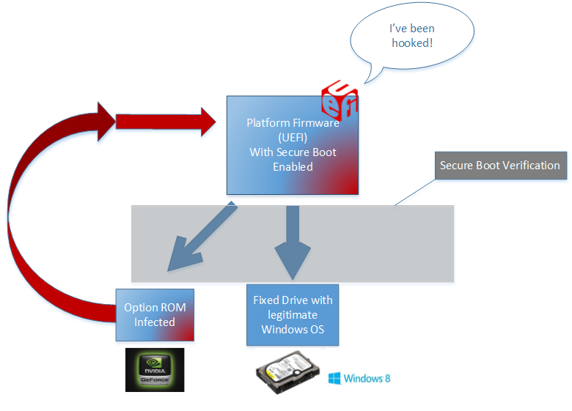
Malicious option rom hooks some code that legitimate Windows boot loader will call later (think old school BIOS rootkit IVT hooking).
* The actual flash chip contents aren’t modified here, only in-memory copies of relevant firmware code/structures.

Slide 17
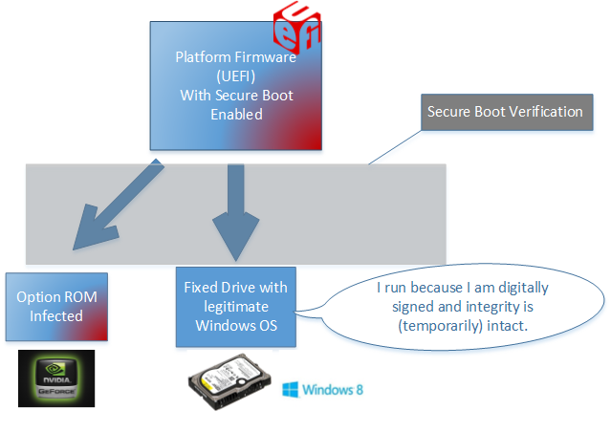
Legitimate boot loader proceeds to execute as normal.

Slide 18
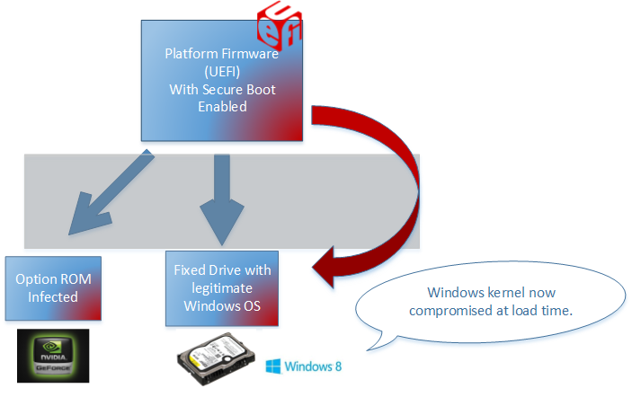
Boot loader is compromised by BIOS code.
Operating system is then later compromised.

Slide 19
Malware has successfully evolved into a more dominant species on the malware food chain.

Slide 20

Limitless possibilities
This is just one example of how you could compromise the rest of a secure booted system if an attacker controlled executable was run due to a relaxed secure boot policy.
There are many other ways an attacker could compromise the rest of the boot chain given this scenario.
Notes:
http://marvel-cinematic-universe.wikia.com/wiki/Tesseract

Slide 21
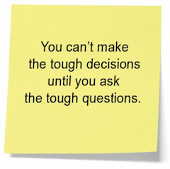
What does the secure boot policy look like on real systems?
How can you detect the secure boot policy of the system without manually testing?
Notes:
https://53077f79f9186a4c3655-ed296c5f6b6631ceb800b5287f18673f.ssl.cf3.rackcdn.com/480-65563260e200790e7af69b2ae11be1d7acf9d546.jpg http://www.sunzu.com/articles/why-is-it-so-tough-to-ask-the-tough-questions/

Slide 22
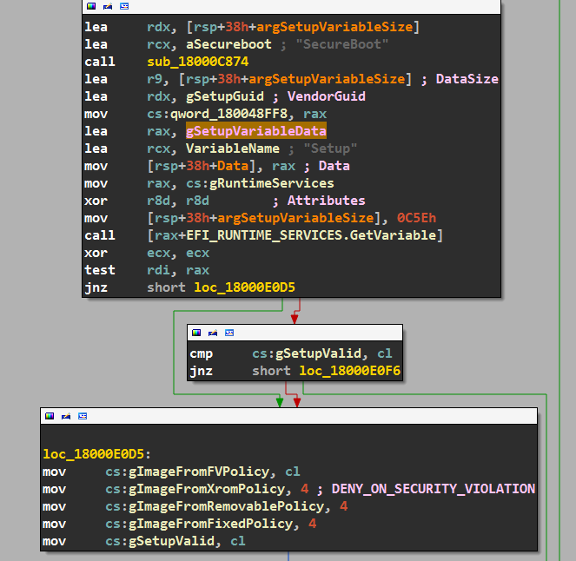
The above shows disassembly of the secure boot policy initialization on Dell Latitude E6430 BIOS revision A12.

Slide 23
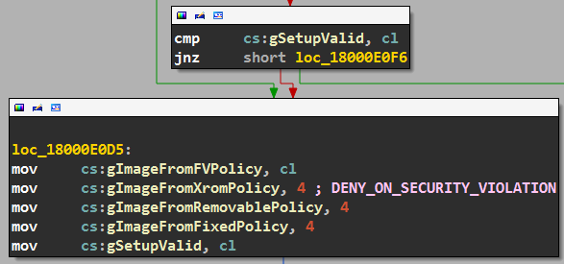
The Secure Boot policy can be either hardcoded, or derived from the EFI “Setup” variable.
It turns out the contents of the “Setup” variable makes this determination.

Slide 24
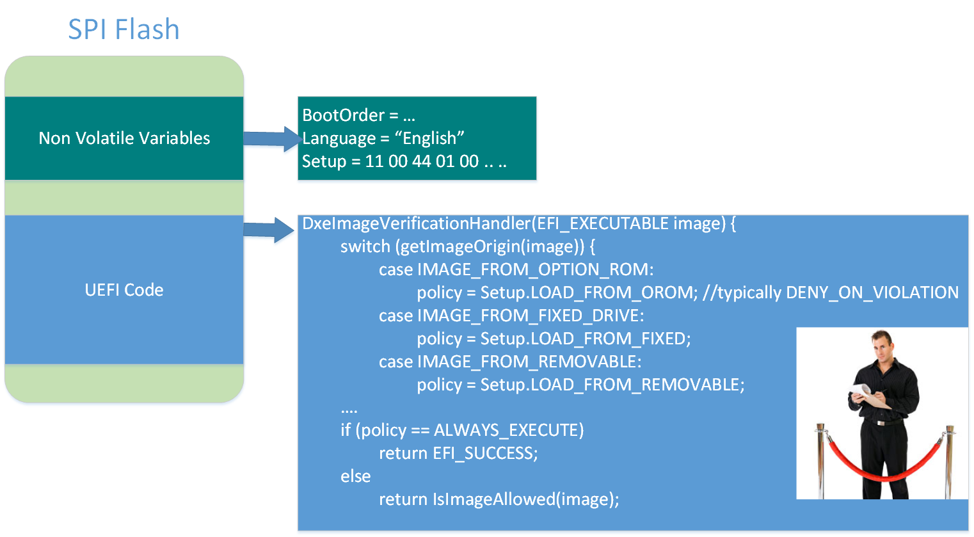

The EFI variables are typically stored on the SPI Flash chip that also contains the platform firmware (UEFI code).

Slide 25

Cross Roads
The Dell’s I looked at did not have relaxed option rom policies as I had previously hypothesized.
The EFI “Setup” variable became my next target of attention.
Notes:
Papa Legba Hear My Call!
http://upload.wikimedia.org/wikipedia/commons/6/69/PapaLegbaCharlesSanderson.jpg

Slide 26
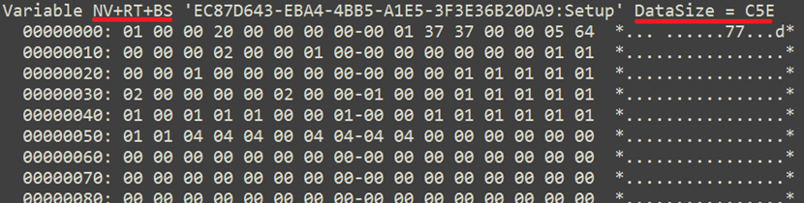
Setup variable is marked as Non-Volatile (Stored to flash chip), and as accessible to both Boot services and Runtime Services.
We should be able to modify it from the operating system.
It’s also quite large… lots of stuff in here!

Slide 27
Secret Protections?
The Setup variable is of obvious importance to the security of the platform, which made me wonder if there was some secret protection that would prevent me from writing to it.
As a first attempt to demonstrate I could write to the Setup variable from Windows, I tried to just zero out the variable. This turned out to be a very bad idea…

Slide 28
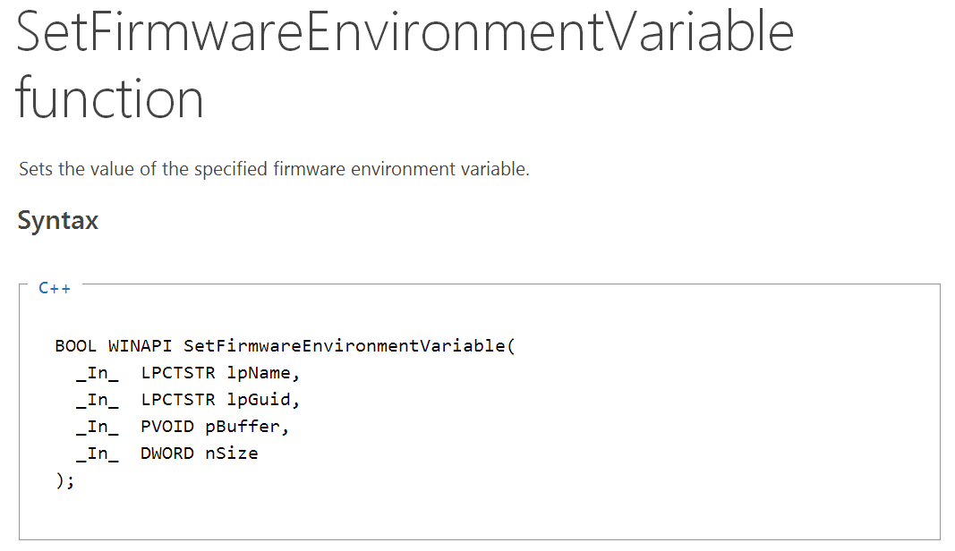
Starting in Windows 8, Microsoft provides an API for interacting with EFI non volatile variables.

Slide 29
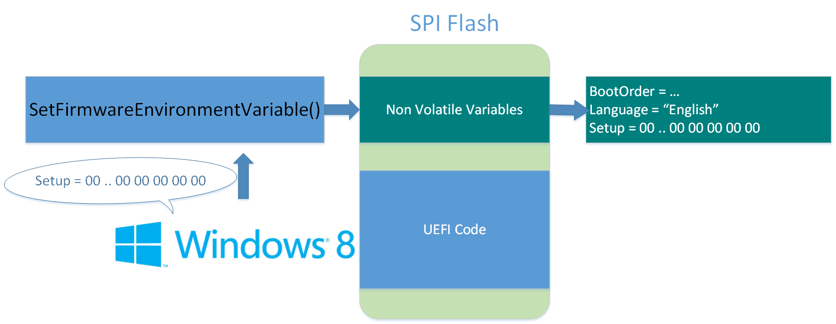
Any guesses as to what happened?

Slide 30
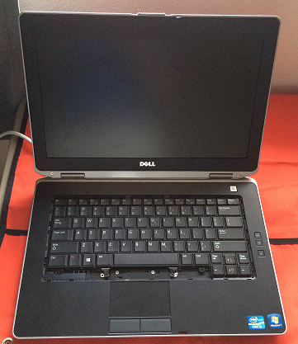
Hint: you can tell I’ve already taken the laptop apart (this picture was taken post-surgical-recovery).

Slide 31
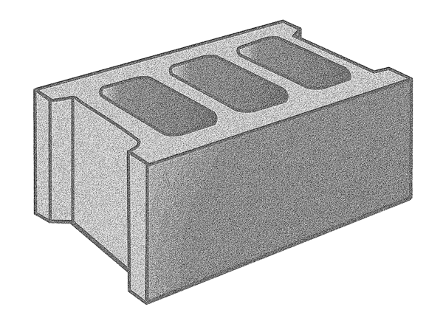
Hint: you can tell I’ve already taken the laptop apart (this picture was taken post-surgical-recovery).

Slide 32
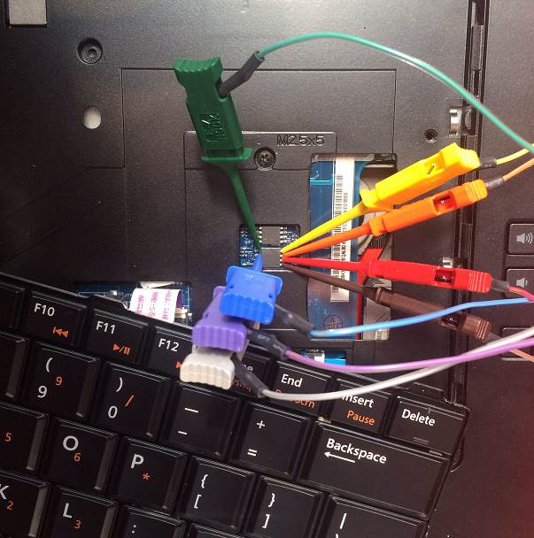
Having to fix this would be very unpleasant for your organization.

Slide 33
Back on target
Although devastating, bricking the firmware is “just” a denial of service attack.
Let’s get back to trying to break secure boot.

Slide 34
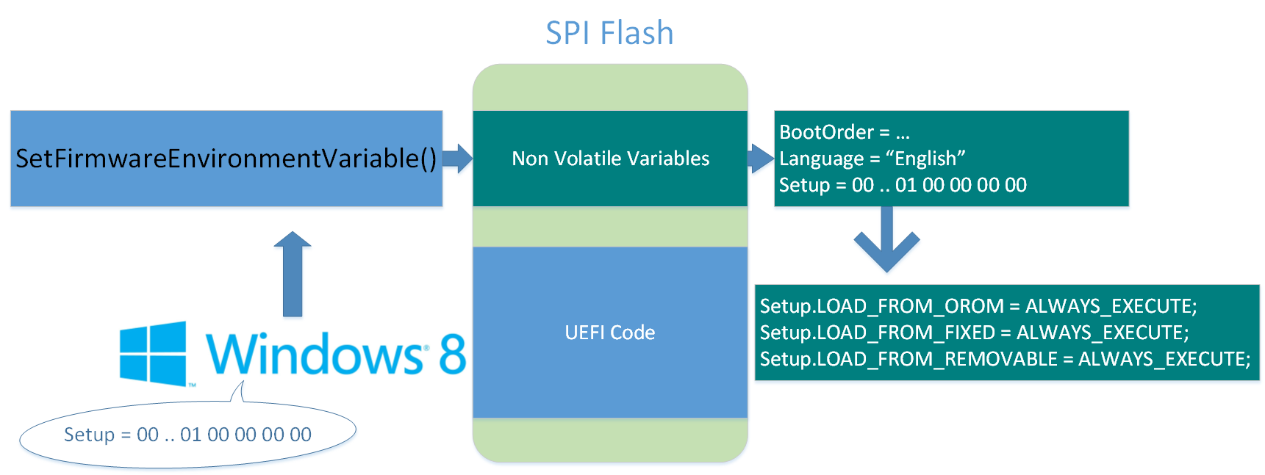
By twiddling the bits in the Setup variable, we can:
Force the firmware to used the Setup defined Secure Boot policy
Force the Secure Boot policy to “ALWAYS_EXECUTE” everything, no matter if it is signed or not.

Slide 35
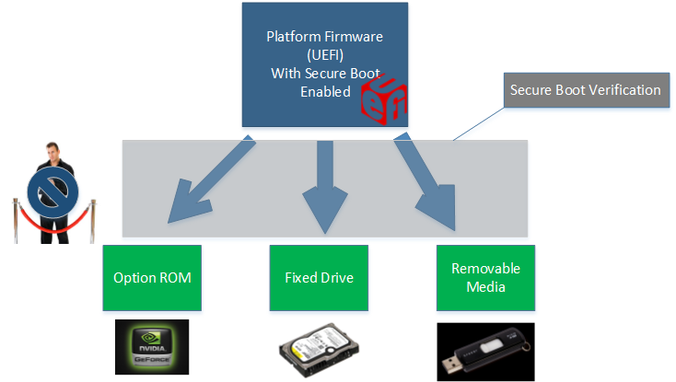
All executables, no matter their origin or whether or not they are signed are now allowed to execute.
Secure boot is still “enabled” though it is now effectively disabled.

Slide 36
Attack 1 Summary
Malicious Windows 8 privileged process can force unsigned executables to be allowed by Secure Boot
Exploitable from userland
Bootkits will now function unimpeded
Secure Boot will still report itself as enabled although it is no longer “functioning”
Co-discovered by Intel team

Slide 37
Attack 1 Corollary
Malicious Windows 8 privileged process can force can “brick” your computer
Reinstalling the operating system won’t fix this
Exploitable from userland

Slide 38
Who is responsible?
We first identified this vulnerability on a Dell Latitude E6430.
Is this problem specific to the E6430?
Is this problem specific to Dell?
Is this vulnerability present in the UEFI reference implementation?

Slide 39
Who is to responsible?
We first identified this vulnerability on a Dell Latitude E6430.
Is this problem specific to the E6430? No.
Is this problem specific to Dell? No.
Is this vulnerability present in the UEFI reference implementation? No.

Slide 40
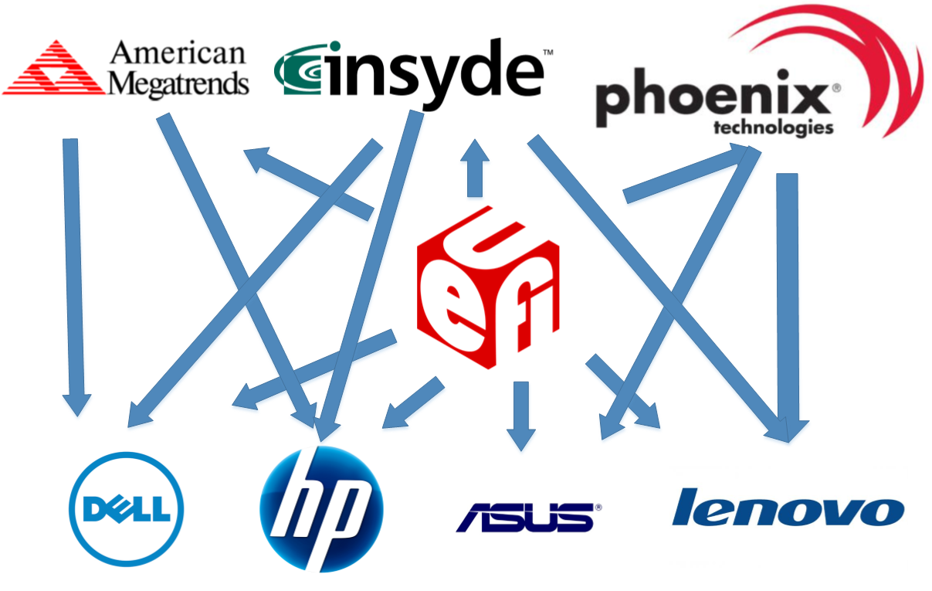
In theory:
UEFI specifies how platform firmware should be developed and provides a reference implementation.
Independent BIOS Vendors develop platform firmware based on UEFI specification and reference implementation.
OEMs get the firmware development frameworks from the IBVs, and customize it to their own needs.

Slide 41
In practice:
OEMs will use different IBVs for different computer models. Firmware can vary dramatically between computers of the same OEM.
Sometimes OEMs won’t use IBV code at all, and will instead choose to “roll their own.”
IBVs may or may not actually use the UEFI reference implementation code.

Slide 42
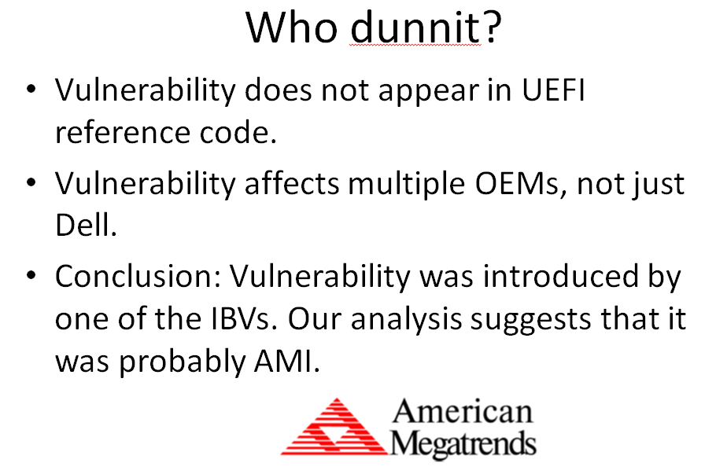

ADDENDUM:
Our initial analysis led us to incorrectly conclude that the vulnerability was introduced by the IBV American Megatrends
Further analysis as to the source of this vulnerability is pending

Slide 43
Authenticated Variables
We’ve seen how EFI variables that are writeable by the Operating System can potentially be abused.
But not all EFI variables are arbitrarily writeable during the “runtime phase” of the system.
Authenticated variables require knowledge of a private key in order to be modified.

Slide 44
Authenticated Variables
Authenticated variables store critical Secure Boot information such as:
The list of authorized keys by which an EFI executable can be signed in order to function with Secure Boot.
A list of “allowed hashes” for EFI executables.
A list of “denied hashes” for EFI executables.
Etc.
Authenticated variables co-exist on the SPI flash chip with the platform firmware.

Slide 45
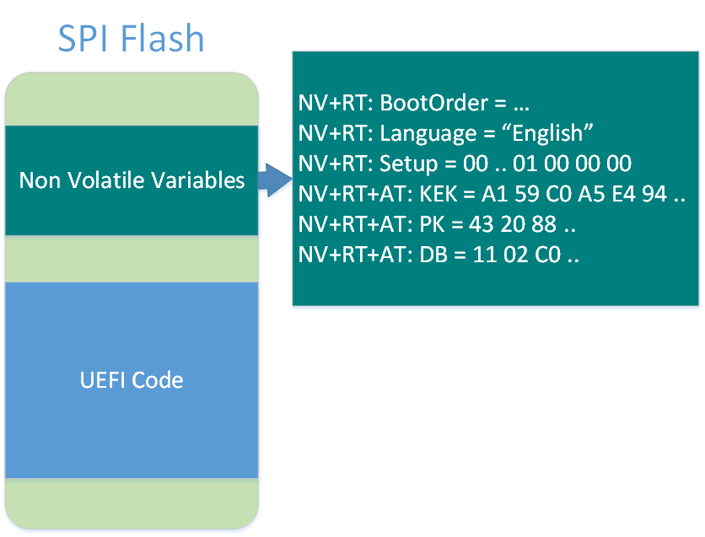
SPI Flash is getting crowded, we have:
The UEFI code which should not be arbitrarily writeable at runtime.
Authenticated EFI Variables which are writable if knowledge of a private key is proven.
Non-Authenticated Runtime variables, which should be arbitrarily writeable by the operating system.

Slide 46
How can OEMs implement the different write-ability properties of these different components, which all exist on the same medium (SPI Flash)?

Slide 47
Intel SPI Flash Protection Mechanisms
Intel provides a number of protection mechanisms that can “lock down” the flash chip.
It’s up to OEMs/IBVs to use these Intel provided mechanisms in a coherent way to implement things like:
UEFI variable protection
Signed firmware update requirement

Slide 48
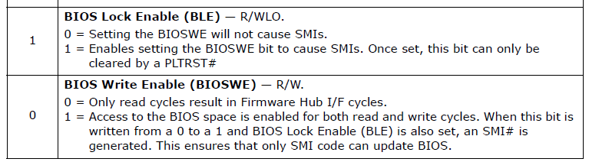
BIOS_CNTL
The above bits are part of the BIOS_CNTL register on the ICH.
BIOS_CNTL.BIOSWE bit enables write access to the flash chip.
BIOS_CNTL.BLE bit provides an opportunity for the OEM to implement an SMM routine to protect the BIOSWE bit.
from: http://www.intel.com/content/www/us/en/chipsets/6-chipset-c200-chipset-datasheet.html

Slide 49
SMM BIOSWE protection (1 of 2)
SMM Code
BIOS_CNTL
BIOSWE = 0
BLE = 1
Ring 0 Kernel Code
BIOSWE = 1
Here the attacker tries to set the BIOS Write Enable bit to 1 to allow him to overwrite the BIOS chip.

Slide 50
SMM BIOSWE protection (2 of 2)
SMM Code
SMI#
BIOS_CNTL
BIOSWE = 1
BLE = 1
Ring 0 Kernel Code
The write to the BIOSWE bit while BLE is 1 causes the CPU to generate a System Management Interrupt (SMI#).

Slide 51
SMM BIOSWE protection (2 of 2)
SMM Code
BIOSWE = 0
BIOS_CNTL
BIOSWE = 1
BLE = 1
RSM
Ring 0 Kernel Code
The SMM code immediately writes 0 back to the BIOSWE bit before resuming the kernel code

Slide 52
SMM BIOSWE protection (2 of 2)
SMM Code
BIOS_CNTL
BIOSWE = 0
BLE = 1
Ring 0 Kernel Code
The end result is that BIOSWE is always 0 when non-SMM code is running.

Slide 53
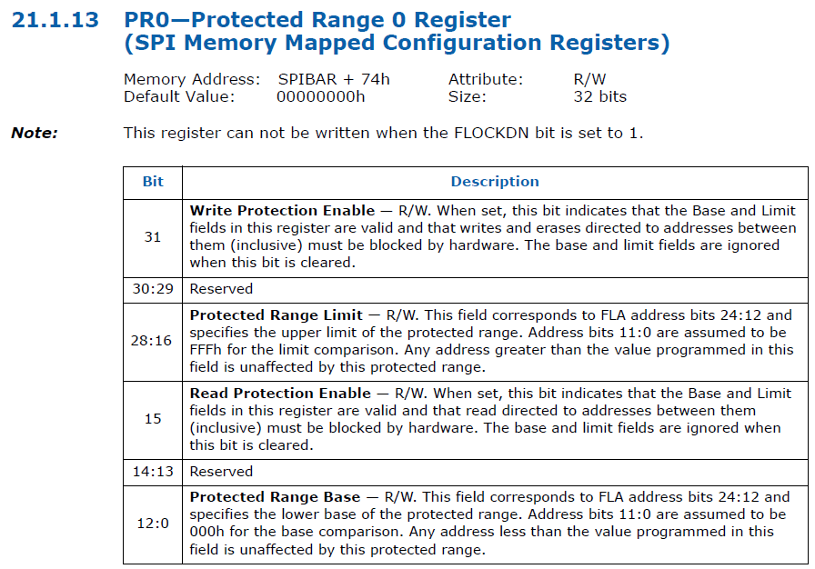
Protected Range SPI Flash Protections
Protected Range registers can also provide write protection to the flash chip.

Slide 54
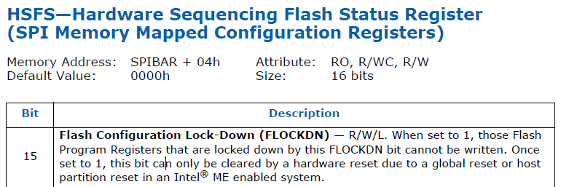
HSFS.FLOCKDN
HSFS.FLOCKDN bit prevents changes to the Protected Range registers once set.

Slide 55
Intel Protections Summary
The Protected Range and BIOS_CNTL registers provide duplicative protection of the SPI flash chip that contains the platform firmware.
Protected Range registers can be configured to block all write access to ranges of the SPI Flash.
BIOS_CNTL protection puts SMM in a position to decide who can write to the SPI Flash.

Slide 56
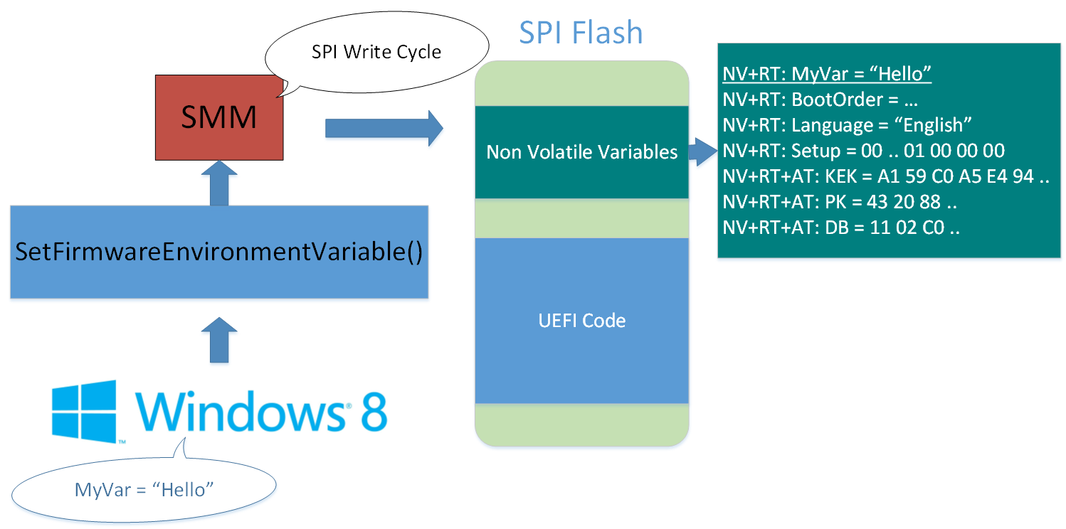
The architecture of the UEFI variable implementation requires SMM to perform the actual writing.
The alternative would be to allow Ring0 code write access to the variable region of the SPI Flash, which would allow malicious Ring0 code to bypass Secure Boot.

Slide 57
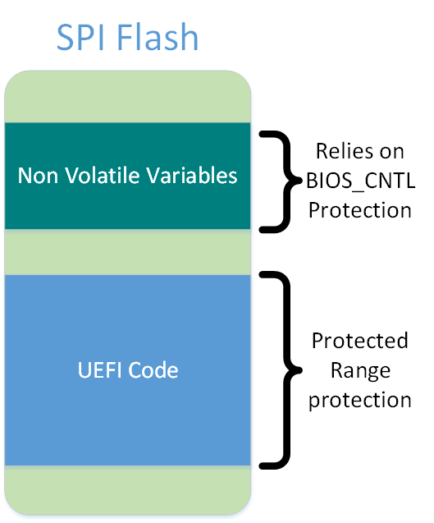
The key observation is that the variable region of the flash cannot use protected range protection, as it has to be writeable by someone at runtime.
Instead, the variable region has to rely on the “strength” of BIOS_CNTL protection.

Slide 58
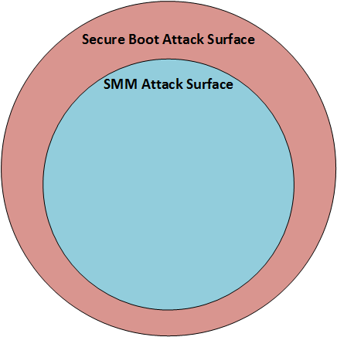
The Authenticated Variable dependency on BIOS_CNTL protection dictates that the attack surface against Secure Boot is a superset of the attacks against SMM.

Slide 59
SMM is bullet proof right?
SMM Cache Poisoning vulnerabilities
Duflot and Invisible Things Lab
“Getting into the SMRAM: SMM Reloaded” by Duflot
“Attacking Intel BIOS” by Invisible Things Lab
“Defeating Signed BIOS Enforcement” by MITRE

Slide 60
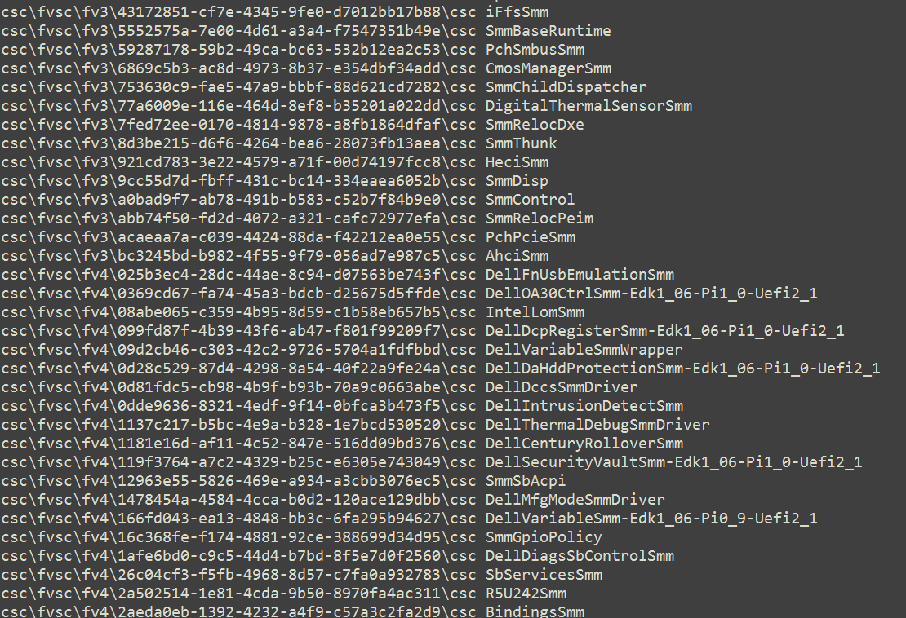
SMM and UEFI
Of the 495 individual EFI modules on my Dell Latitude E6430, 144 appear to contribute code to SMM…

Slide 61
Disturbing Trend
Although SMM should be treated as a “trusted code base” due to its security critical nature, the amount of code executing in SMRAM appears to be on an upward trajectory
Expect more vulnerabilities here in the future, any of which could be used to bypass Secure Boot.

Slide 62
Today’s Result
BIOS_CNTL protection of the SPI Flash can be defeated on a large number of systems by temporarily suppressing SMM.
Attack does not require arbitrary code execution in SMM.
But how can we suppress SMM?

Slide 63
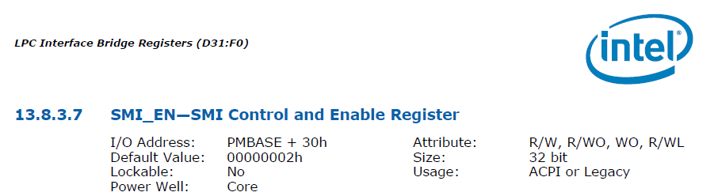
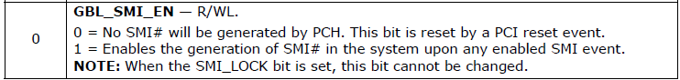
On systems without SMI_LOCK set, we can temporarily disable SMIs and write to flash regions relying on BIOS_CNTL protection, like the EFI variable region.
3216 of 8005 (~40%) systems surveyed did not have SMI_LOCK set.
A greater number could probably be made vulnerable by downgrading the BIOS to a vulnerable revision, which is usually allowed.
Source: Intel 8-series-chipset-pch-datasheet.pdf

Slide 64
Disabled BIOSWE protection (1 of 2)
SMM
BIOS_CNTL.BIOSWE = 1
Ring0 Code
BIOS_CNTL
Again the attacker tries to set the BIOS Write Enable bit to 1 to allow him to overwrite the BIOS chip.

Slide 65
Disabled BIOSWE protection (2 of 2)
SMM
OK: BIOS_CNTL.BIOSWE = 1
Ring0 Code
BIOS_CNTL
This time the SMI that protects BIOSWE fails to fire.

Slide 66
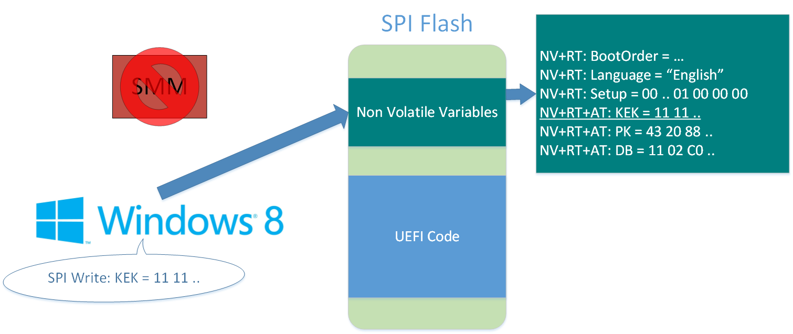
Ring0 can now modify authenticated EFI Variables, which allows trivial bypassing of Secure Boot.

Slide 67
Demo
Demo video

Slide 68
Other ways to suppress SMM?
Yes.
Chipset dependent, read your chipset documentation ;)

Slide 69
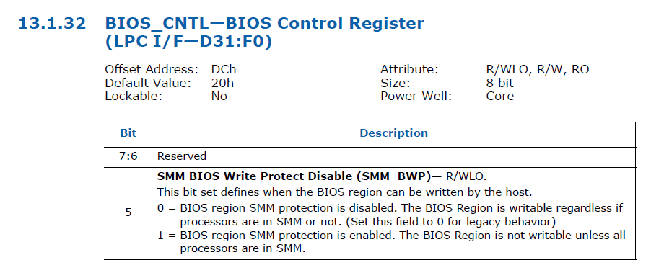
SMM_BWP
SMM_BWP offers a way to prevent malicious Ring0 writes to the SPI Flash even if SMI’s are suppressed.
Source: Intel 8-series-chipset-pch-datasheet.pdf

Slide 70
SMM_BWP
Of the 8005 systems we surveyed, only 6 actually set the SMM_BWP bit.
Source: Intel 8-series-chipset-pch-datasheet.pdf

Slide 71
Attack 2 Summary Part 1
Many OEMs are misconfiguring the Intel provided flash protection mechanisms
On these systems, Secure Boot can be bypassed by a compromised operating system that is able to temporarily suppress SMM and then make direct writes to the authenticated variable region of the flash chip.
Requires Ring0 code execution in Windows

Slide 72
Attack 2 Summary Part 2
It is required that the SPI Flash region associated with EFI variables be writable to at least SMM, thus the protections applied to this region are fundamentally weaker.
This weakness can often be exploited through SMI suppression, leading to a Secure Boot break.
OEMs/IBVs could improve the security of this region by setting SMM_BWP, but most are not doing so currently.

Slide 73
Final Thoughts
UEFI and Secure Boot are good things ultimately for computer security
Attack vectors that were previously open are being addressed
An open source reference implementation should allow us to eventually have something like a trusted code base. This is superior to the “everyone roll’s their own proprietary voodoo” that was prevalent in conventional BIOS.
UEFI still has growing pains it will have to endure

Slide 74
Related Work
“A Tale of One Software Bypass of Windows 8 Secure Boot”
Black Hat USA 2013
First published attack against Secure Boot
If SPI Flash is writable, malicious code with IO access can defeat Secure Boot.
“Defeating Signed BIOS Enforcement”
EkoParty, HITB, PacSec 2013
BIOS_CNTL protection of the SPI Flash can be defeated by SMM present malware.

Slide 75
Acknowledgements
Intel PSIRT team
Rafal Wojtczuk
Rick Martinez
EFIPWN developers

Slide 76

Notes:
http://blog.supermedia.com/media/questions.jpg

